Slide 1

INTRODUCTION TO C

Slide 2
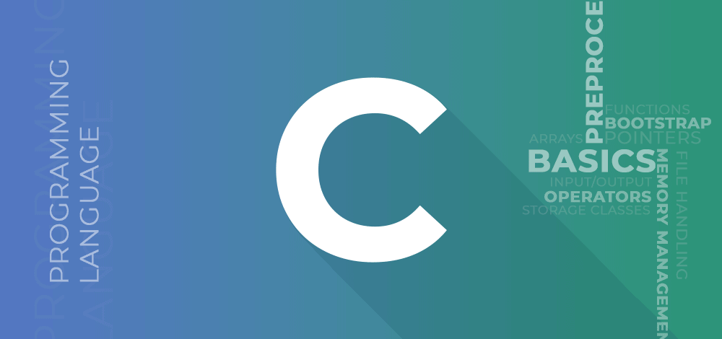
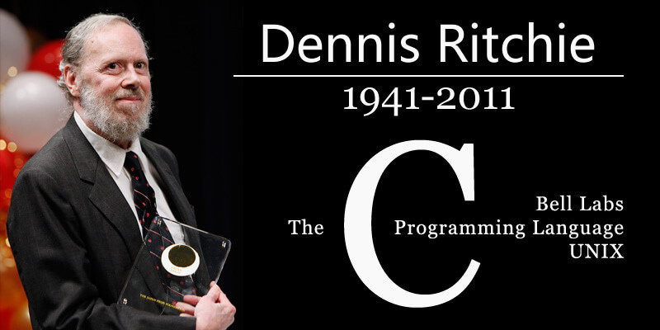
What is C ?
C is a high-level, general-purpose programming language that was developed by Dennis Ritchie at Bell Labs in the early 1970s. It is one of the most widely used programming languages due to its efficiency, flexibility, and ability to provide low-level access to memory.

Slide 3
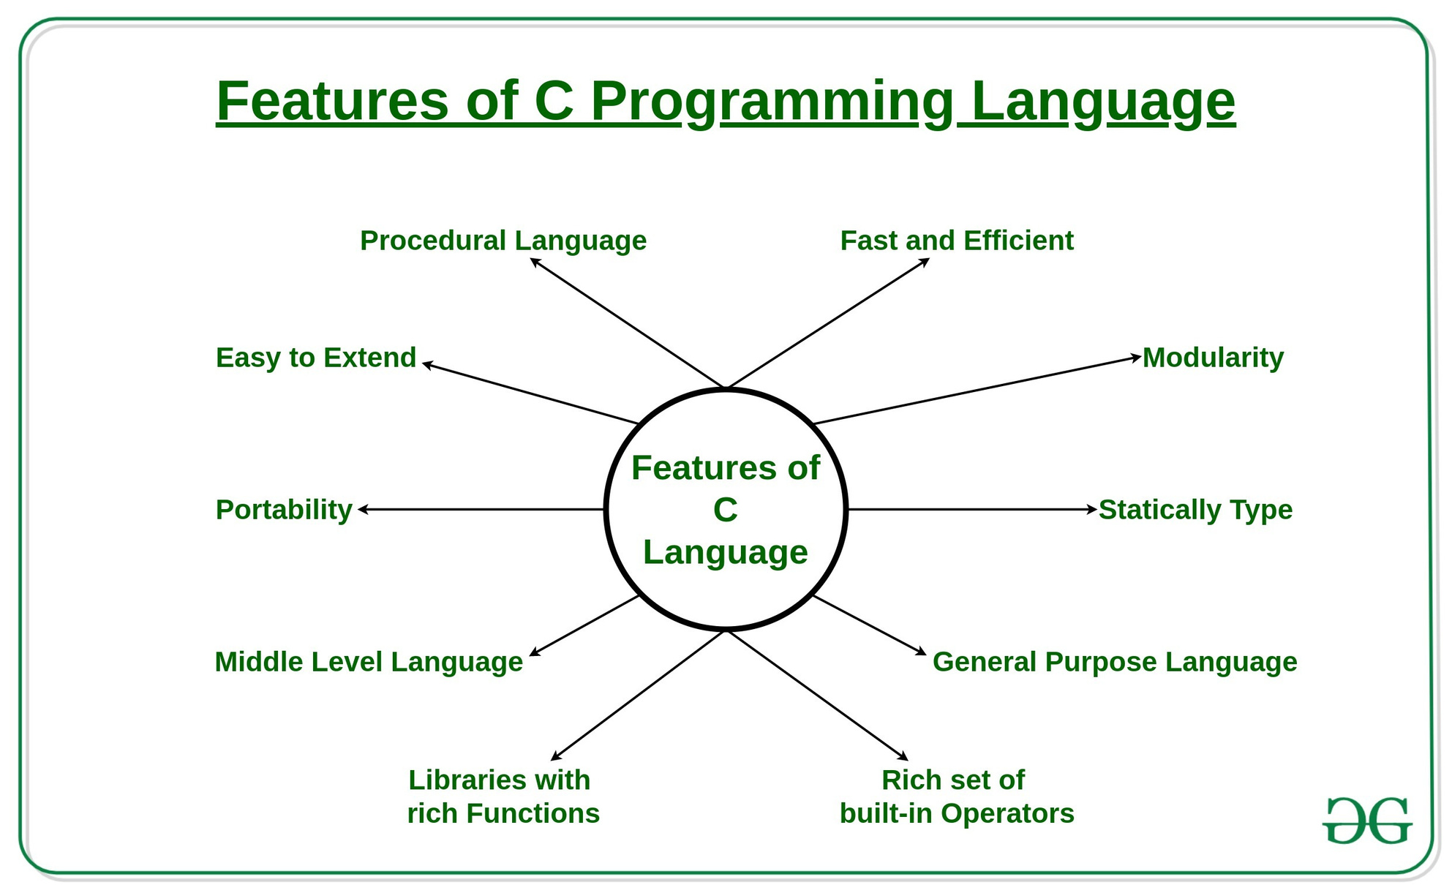
Why C ?
Add Company Name

Slide 4
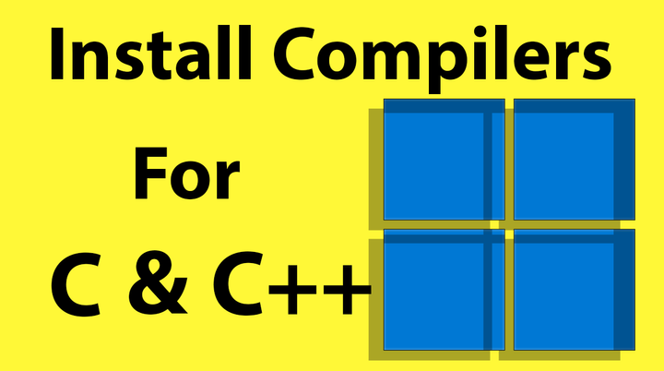
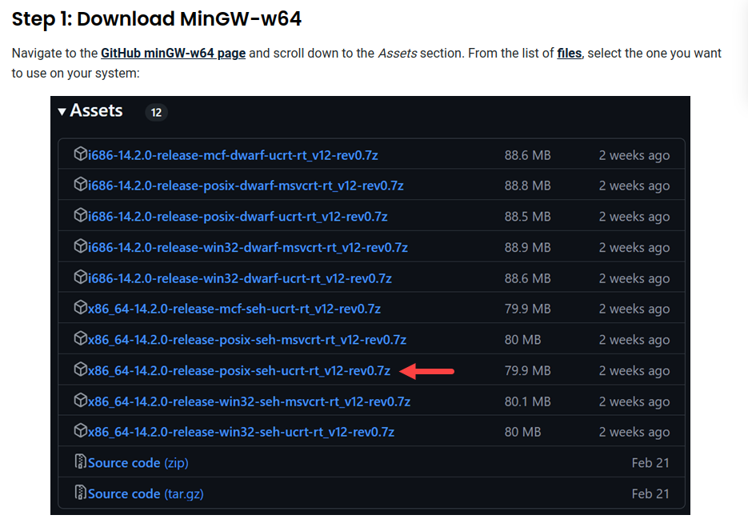
https://github.com/niXman/mingw-builds-binaries/releases

Slide 5
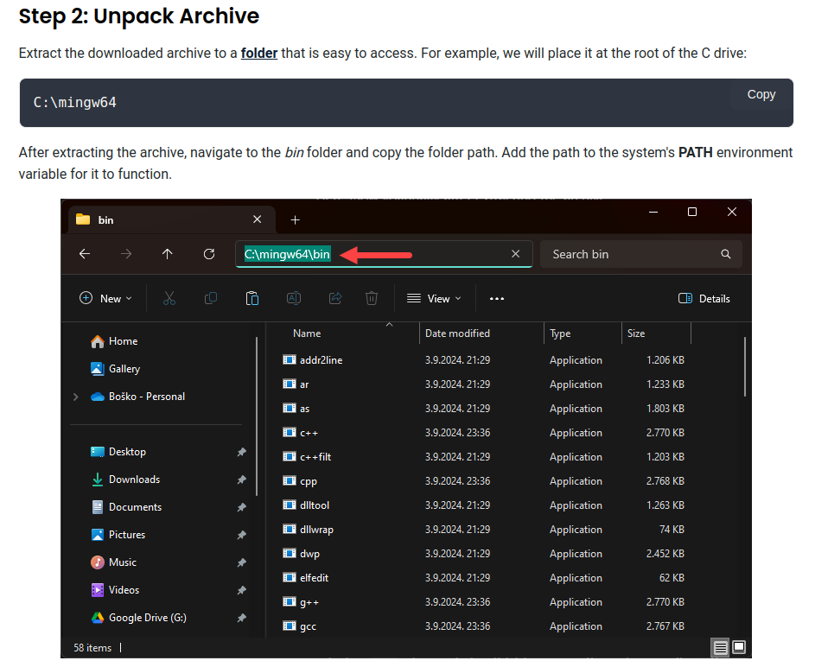
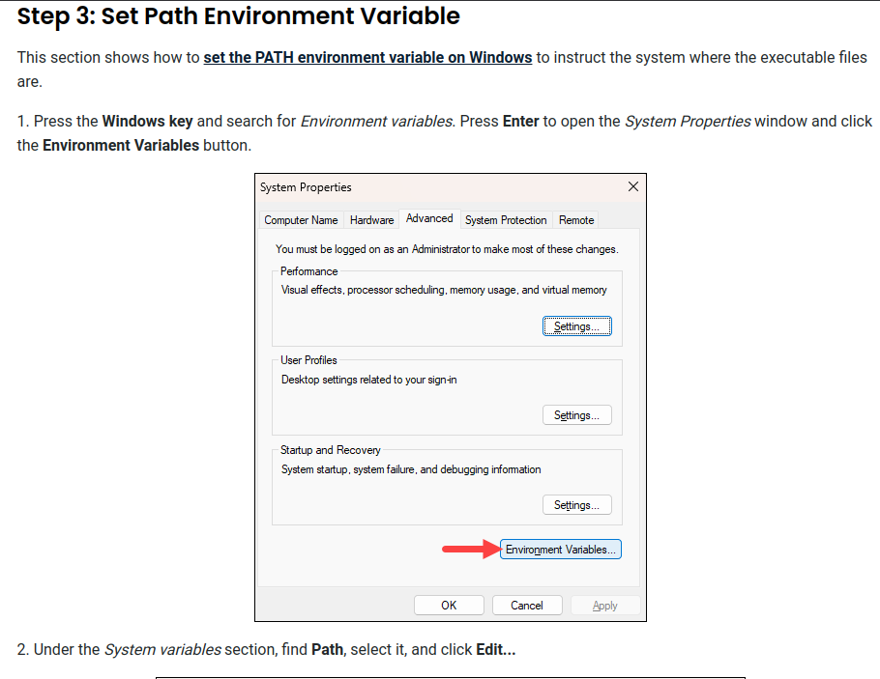

Slide 6
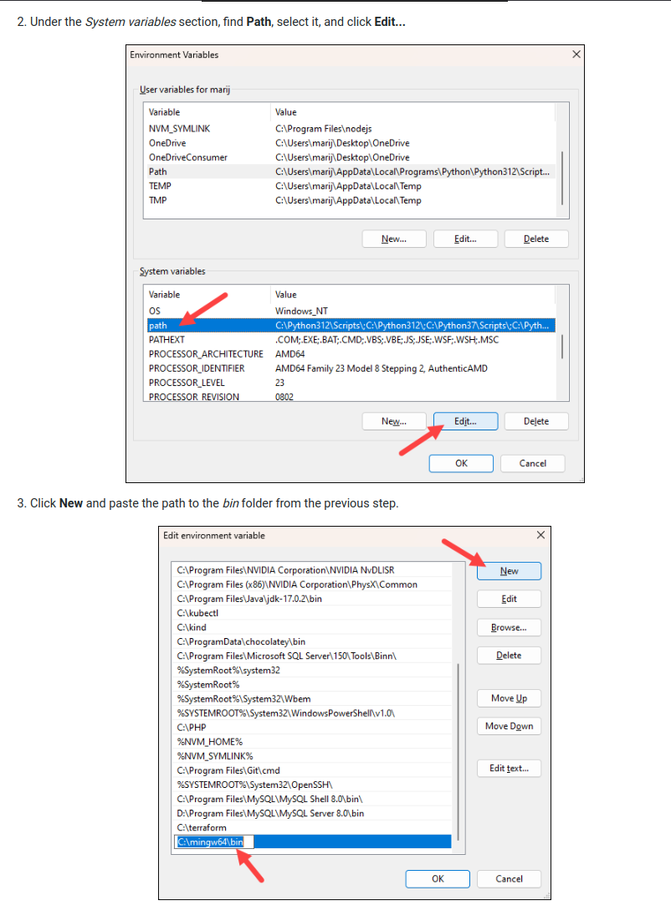
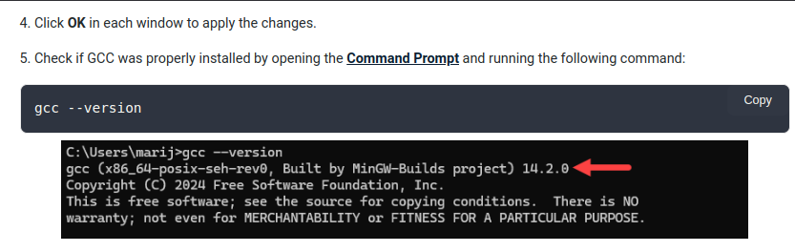

Slide 7
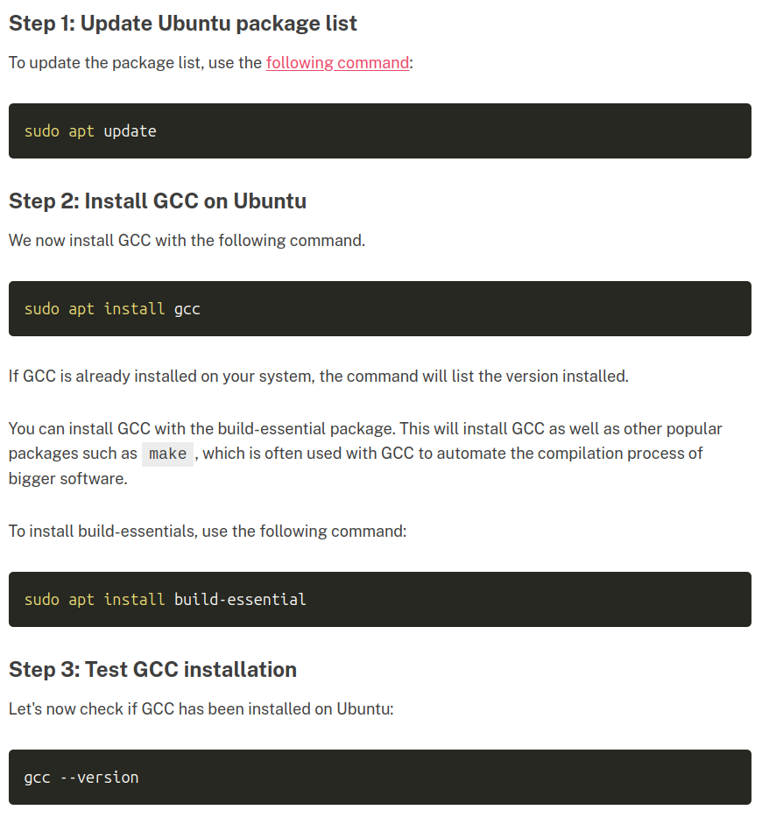


Slide 8
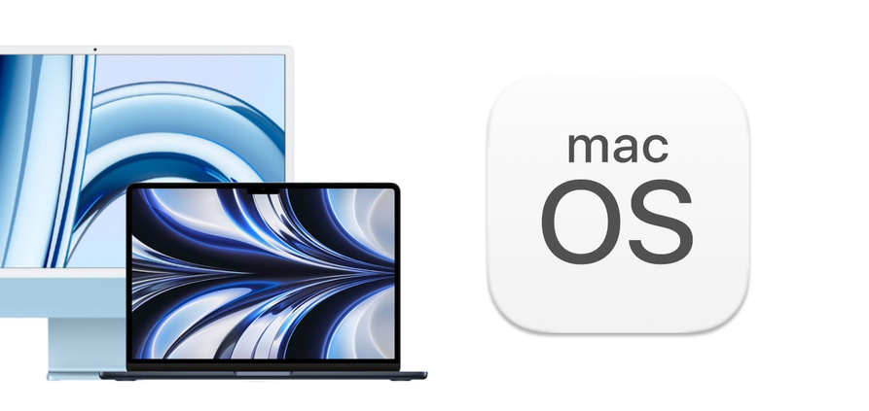
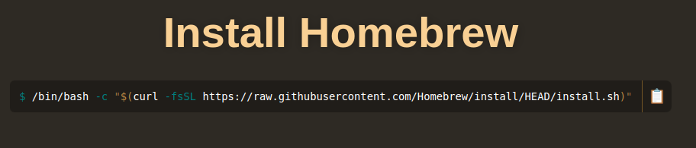
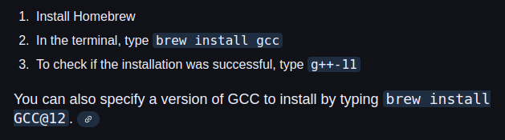

Slide 9
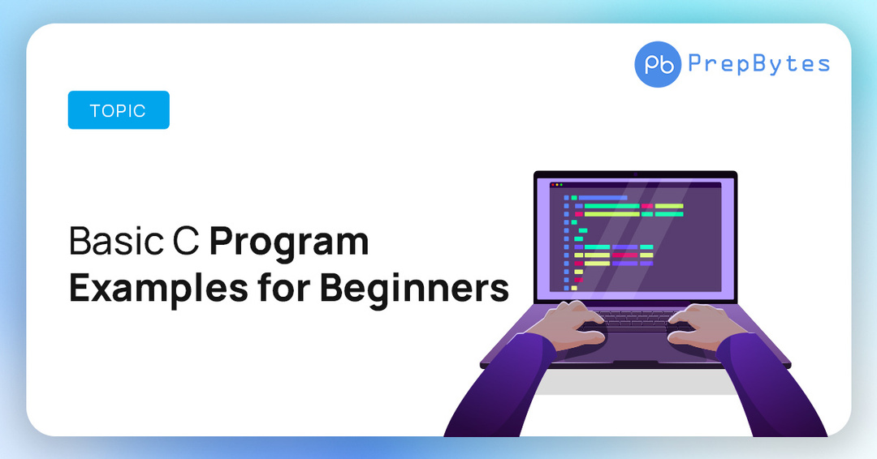
#include <stdio.h>
int main() {
printf("Hello, World! ");
return 0;
}

Slide 10
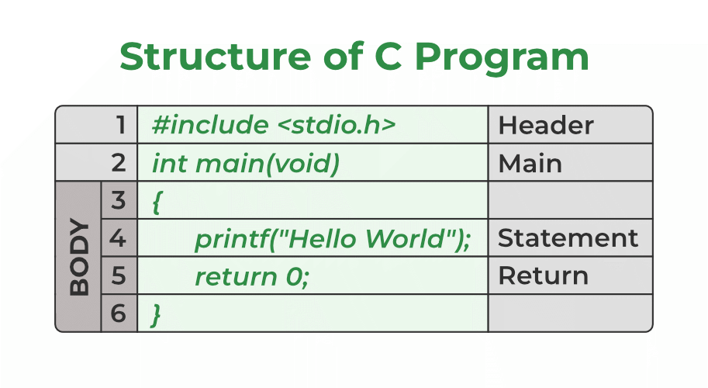
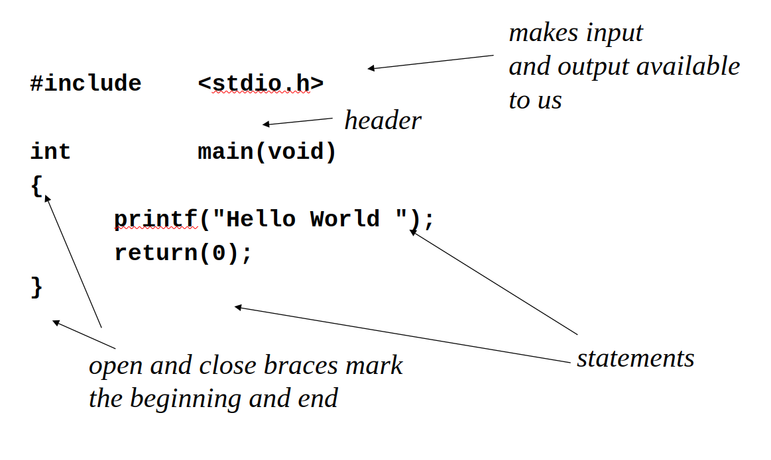

Slide 11
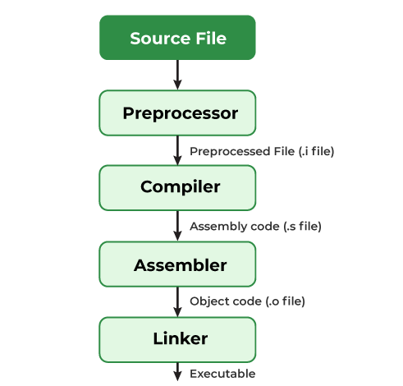
Compiling a C Program: Behind the Scenes
Add Company Name
Back to Agenda Page

Slide 12
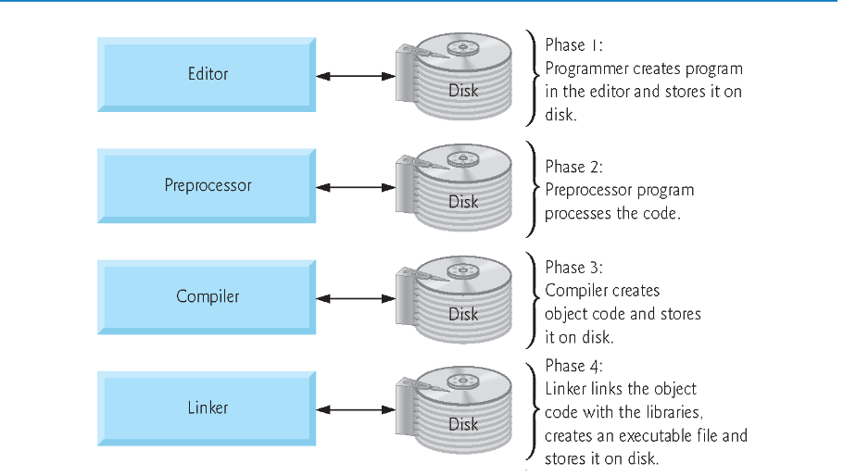
Let’s dive deeper
Add Company Name

Slide 13
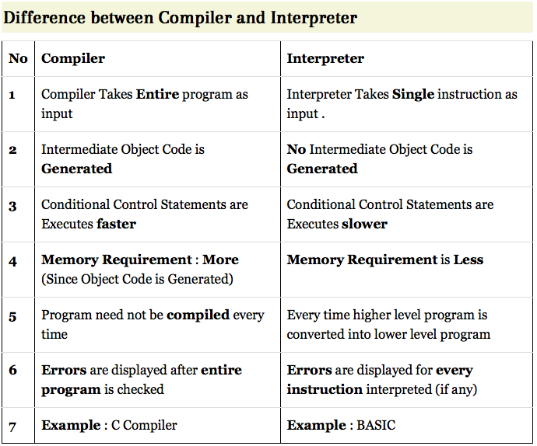

Slide 14
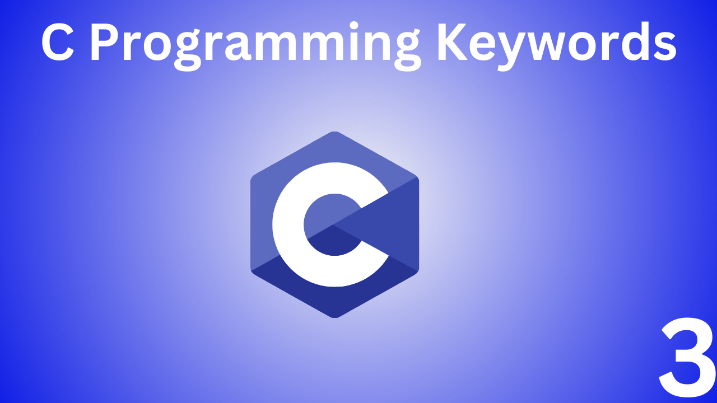
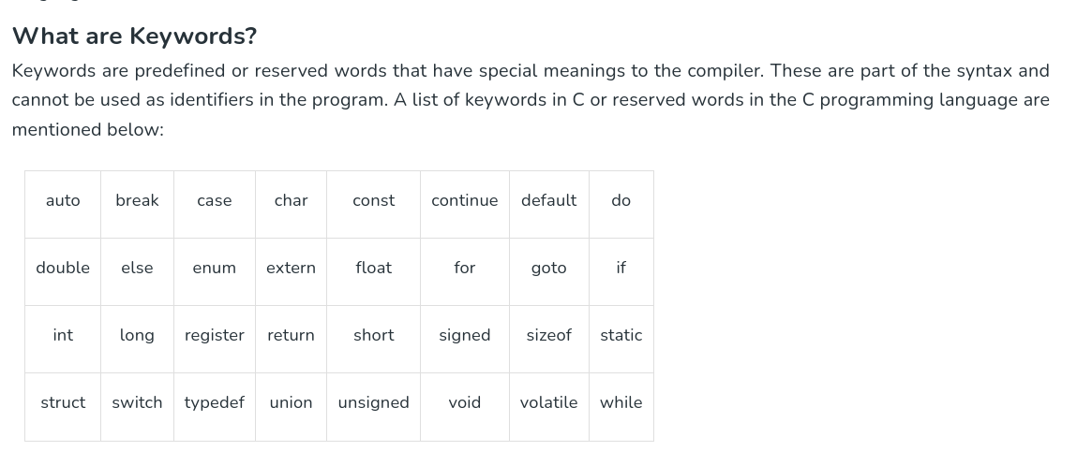

Slide 15
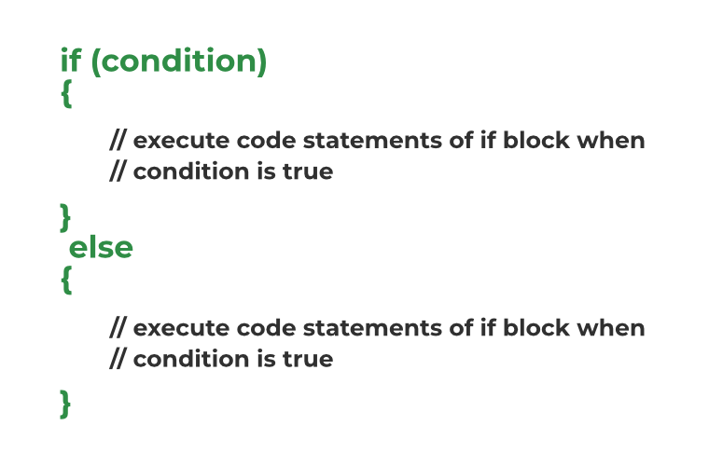
Condtional Statements in C

Slide 16
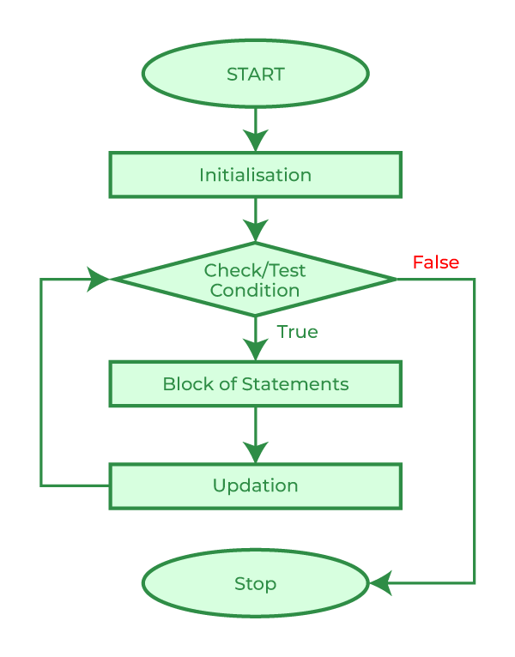
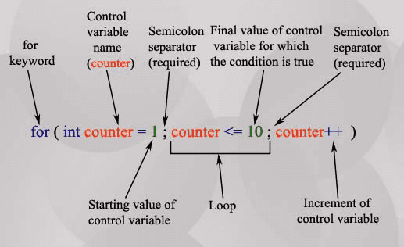
For Loops in C

Slide 17
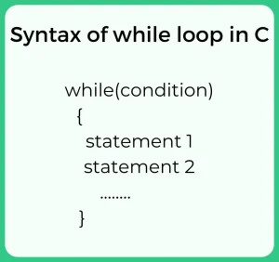
While loops in C

Slide 18
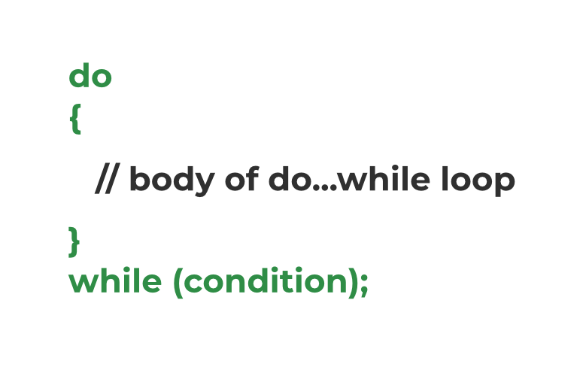
Do While Syntax in C

Slide 19
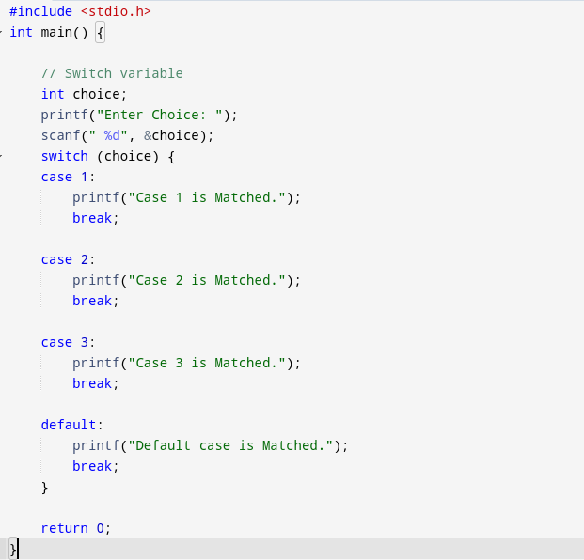
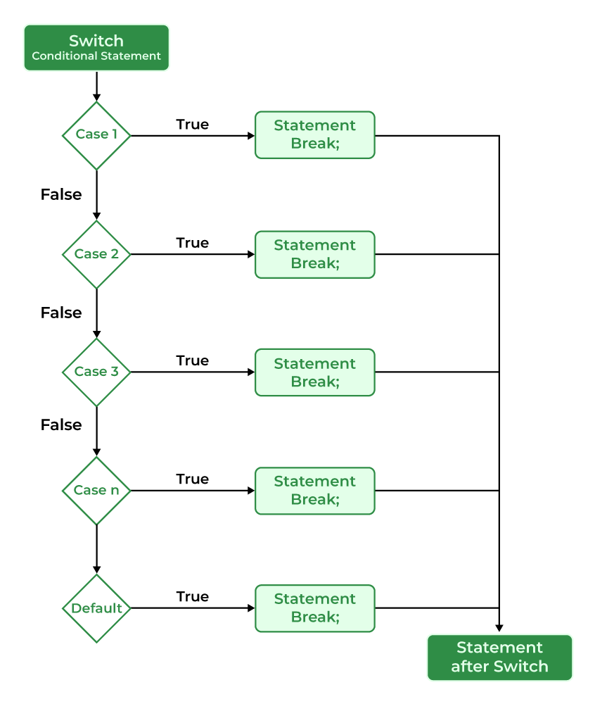

Slide 20
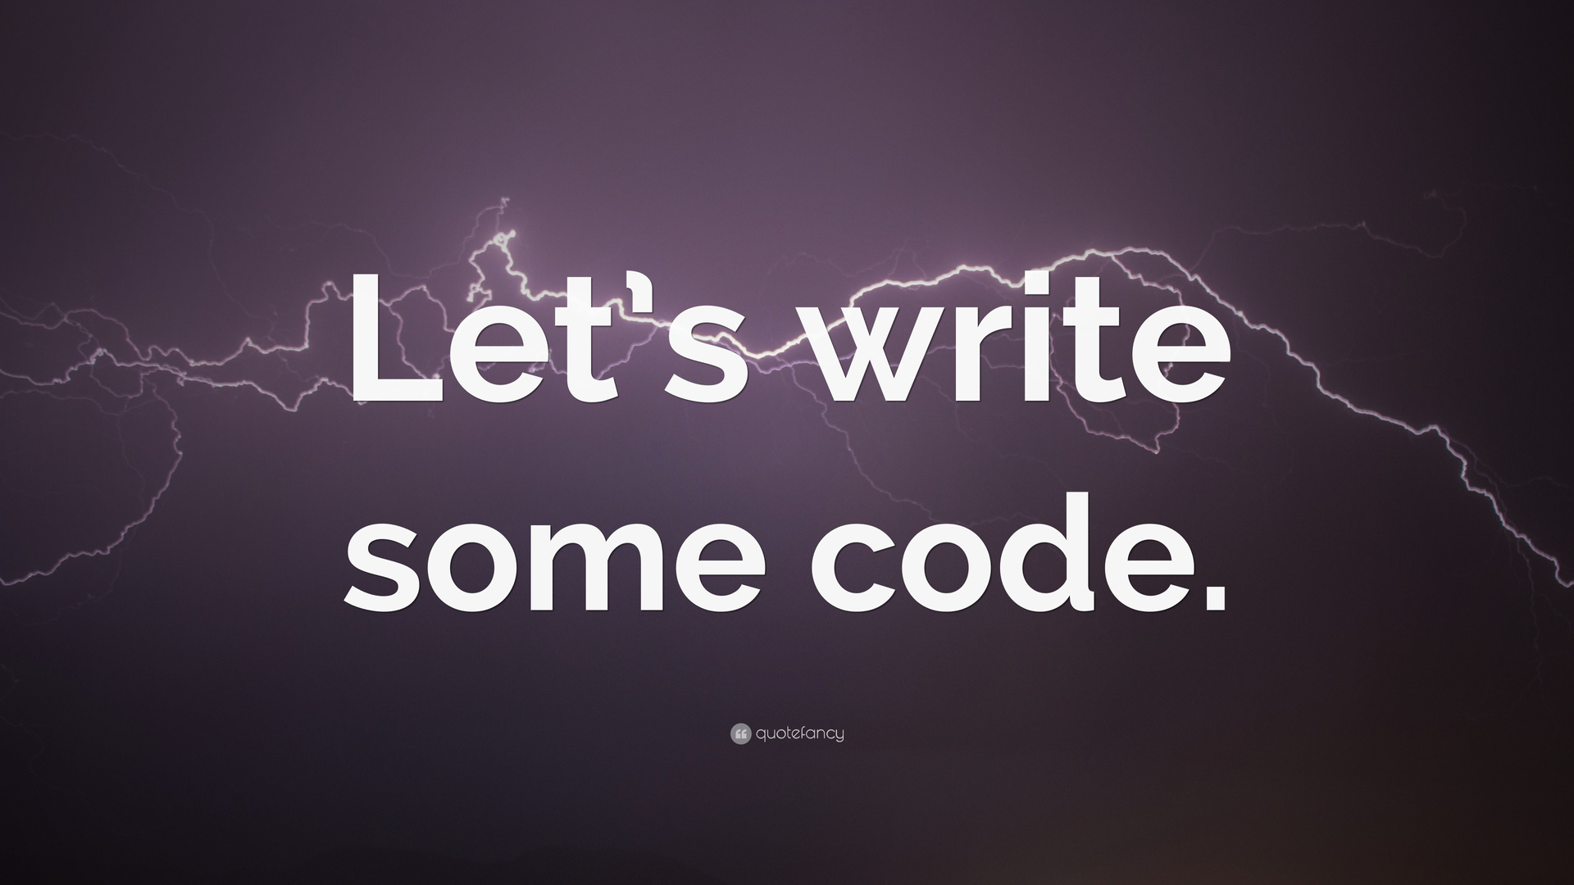

Slide 21

It’s Quiz Time

Slide 22
Q/A Session

Slide 23
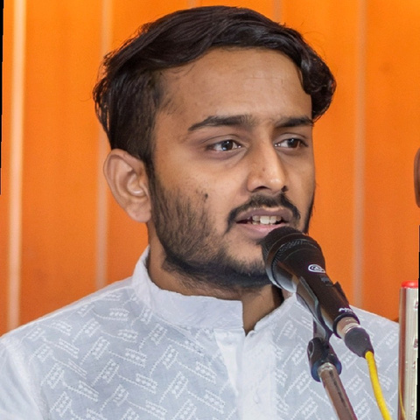
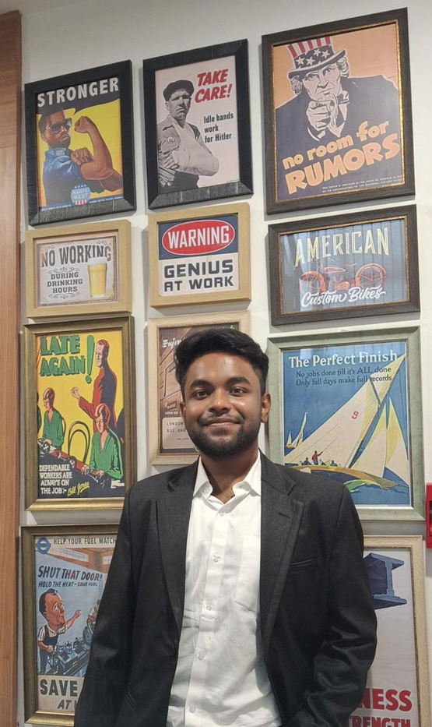




Samyak Mishra
Suprakash Roy
Technical Head
Technical Co Head
LinkedIn Handle
Join for Technical Wing
LinkedIn Handle
Github Handle
My Github Profile
Instagram
Instagram

Slide 24
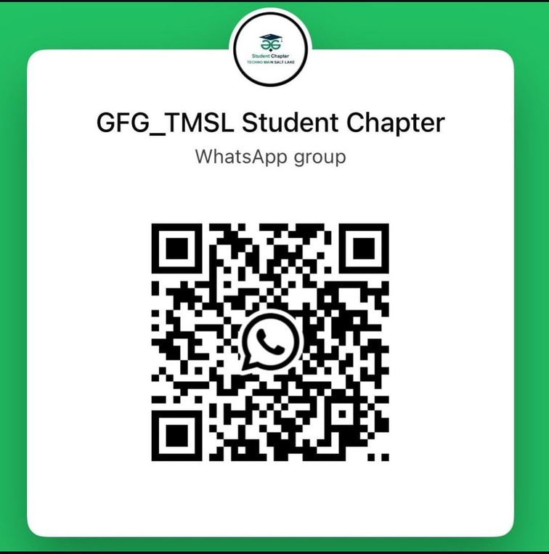


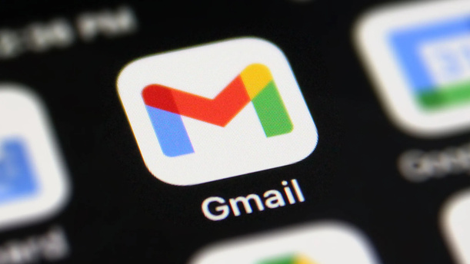
gfg.tmsl.official@gmail.com
LinkedIn

Slide 25
Thank You
Back to Agenda Page

